Slide 1
Rheumatoid arthritis
Clinical Trial status of the field of companies

Slide 2
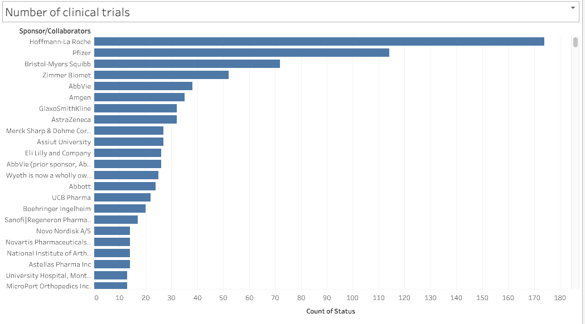
Number of clinical trials

Slide 3
Significance
Previous slide is a graph of about top 20 companies and collaborators that have clinical trials for Arthritis
This shows the major competitors in the field to bring a product to production
Roche and Pfizer are leading the pack with 174 and 114 respectively

Slide 4
Trial phases
PHASE 1: Checking if the drug is safe
PHASE 2: Does the drug work?
PHASE 3: Submission to FDA for approval and if it is better than what is available.
PHASE 4: Commercially available, checking for long term effects.

Slide 5
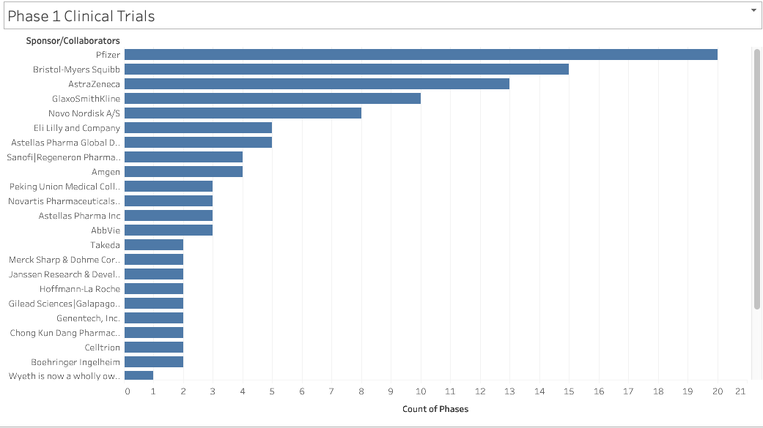
Phase 1 trials

Slide 6
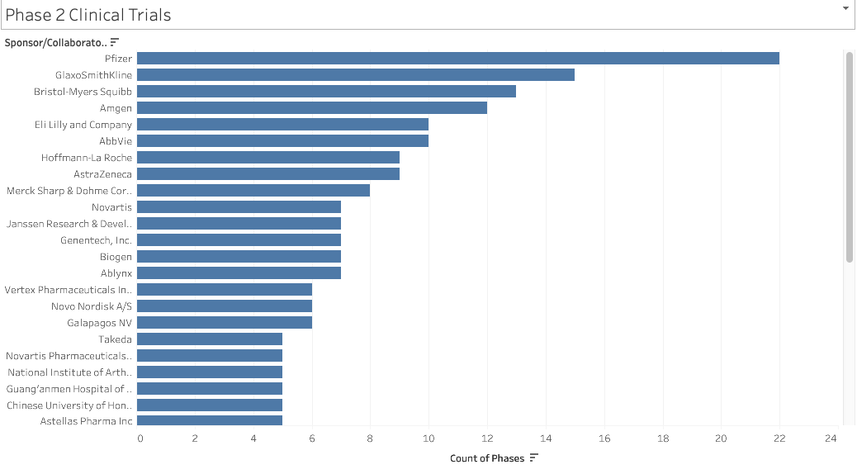
Phase 2 Trials

Slide 7
Significance of phase 1 and 2
Pfizer has the greatest amount of phase 1 and 2 trials.
Showcasing that most of the drugs that are planned are still being tested for safety and if it works. Mostly in the R&D stage.
This would mean that Pfizer feels they have a drug that will have improvements over ones that came before hence if backing a company they need to have a better product than what is available.

Slide 8
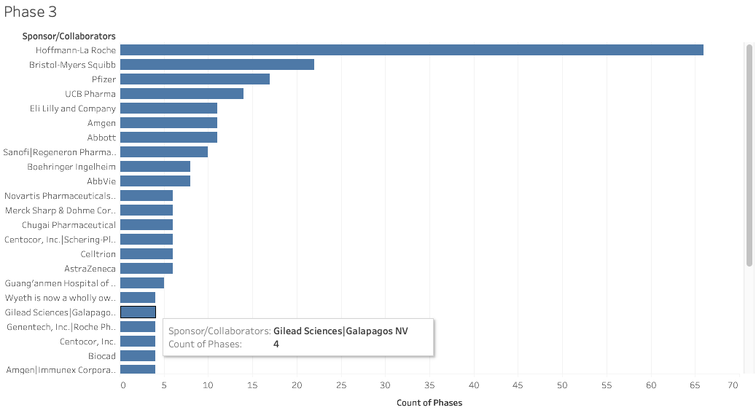
Phase 3 trials

Slide 9
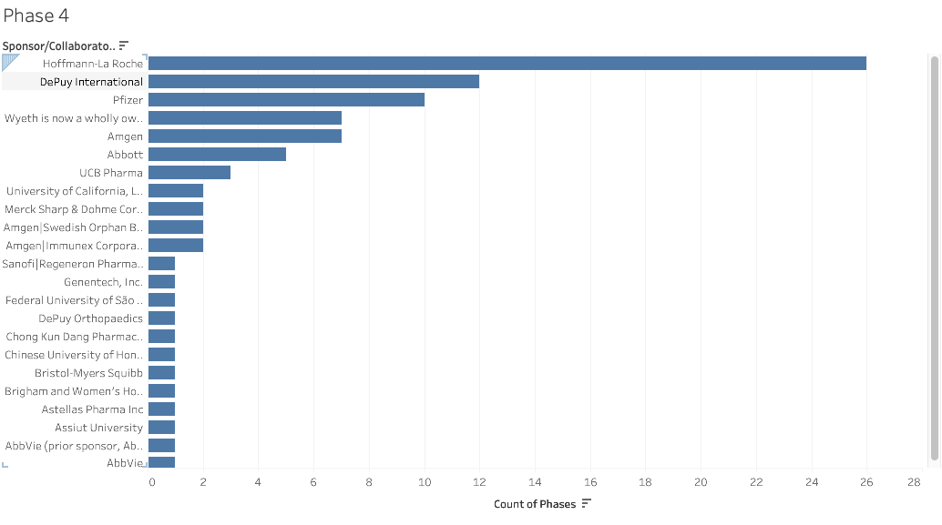
Phase 4 trials

Slide 10
Significance of phase 3 and 4
Roche by far has the most trials in phase 3 and 4
This would mean that most of the drugs are already established and commercially available. Growth will be limited but there will be stability for a time.

Slide 11
Shortcoming of data
Due to the short timeframe I was unable to clean the data to the best of my ability. Involving the split of collaborators and companies, this would have a larger impact on accuracy of what companies are competitive in what stage.
The data has missing information that could be found with further research
Having a clinical trial doesn’t mean that it will go to production

Slide 12
Next steps
Include in financial data to see financial status
Clean data to have clearer separation of competitors
Clean data to have clearer information on the type of drug being used
Clean data to get the efficacy of the drugs.
Add in patent data to know what can be done.

Slide 13
Link to tableau
Tableau workbook

